Slide 1
Computer Organization & Assembly Language (Lecture 15)
Omar Bin Samin
Lecturer
Institute of Management Sciences, Peshawar.

Slide 2
Parallel Processing and Pipelining

Slide 3
What is Parallel Processing?
A parallel processing system is able to perform concurrent data processing to achieve faster execution time
The system may have two or more ALUs and be able to execute two or more instructions at the same time
Goal is to increase the throughput (the amount of processing that can be accomplished during a given time)

Slide 4
Classification of Parallel Processing
SISD – Single Instruction Single Data
SIMD - Single Instruction Multiple Data
MISD – Multiple Instruction Single Data
MIMD - Multiple Instruction Multiple Data

Slide 5
SISD – Single Instruction Single Data
Single Instruction: All processing units execute the same instruction at any given clock cycle
Single Data: A single/ same data stream is fed into all processing units

Slide 6
SIMD - Single Instruction Multiple Data
Single Instruction: All processing units execute the same instruction at any given clock cycle
Multiple Data: Multiple/ different data streams are fed into all processing units

Slide 7
MISD – Multiple Instruction Single Data
Multiple Instruction: All processing units execute the different instructions at any given clock cycle
Single Data: A single/ same data stream is fed into all processing units

Slide 8
MIMD - Multiple Instruction Multiple Data
Multiple Instruction: All processing units execute the different instructions at any given clock cycle
Multiple Data: Multiple/ different data streams are fed into all processing units

Slide 9
Pipelining
A form of computer organization in which successive steps of an instruction sequence are executed in turn, by a sequence of modules able to operate concurrently, so that another instruction can begin before the previous one is finished

Slide 10
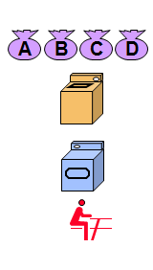
Pipelining: Real Life Example
Laundry Example
Ann, Brian, Cathy, Dave each have one load of clothes to wash, dry and fold
Washer takes 30 minutes
Dryer takes 40 minutes
Folder takes 20 minutes
Total : 90 minutes

Slide 11
6 PM
7
8
9
10
11
Midnight
Time
30
40
20
30
40
20
30
40
20
30
40
20
T
a
s
k
O
r
d
e
r
A
B
C
D
Sequential laundry takes 6 hours for 4 loads
If they learned pipelining, how long would laundry take?

Slide 12
Start Work ASAP
6 PM
7
8
9
10
11
Midnight
Time
30
40
40
40
40
20
T
a
s
k
O
r
d
e
r
A
Pipelined laundry takes 3.5 hours for 4 loads
B
C
D

Slide 13
Facts
Pipelining doesn’t help latency of single task, it helps throughput of entire workload
Pipeline rate is limited by the slowest pipeline stage
Multiple tasks operating simultaneously
Potential speedup = Increasing number of pipe stages
Unbalanced lengths of pipe stages reduces speedup

Slide 14
Let us consider the following decomposition of the instruction processing:
Fetch Instruction (FI): Read the next expected instruction into a buffer
Decode Instruction (DI): Determine the opcode and the operand specifiers
Calculate Operands (CO): Calculate the effective address of each source operand

Slide 15
Fetch Operands (FO): Fetch each operand from memory. Operands in registers need not be fetched
Execute Instruction (EI): Perform the indicated operation and store the result, if any, in the specified destination operand location
Write Operand (WO): Store the result in memory

Slide 16
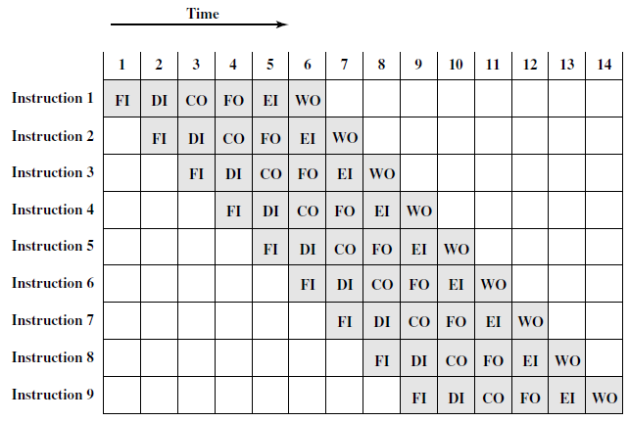
Timing Diagram for Instruction Pipeline Operation

Slide 17
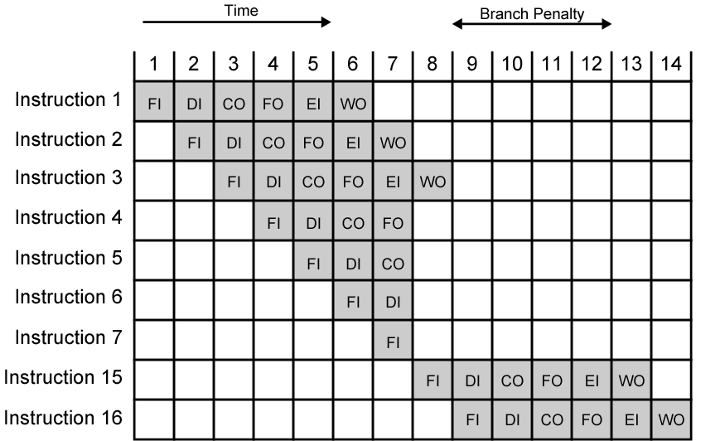
The Effect of a Conditional Branch on Instruction Pipeline Operation

Slide 18
Pipeline Hazard
A pipeline hazard occurs when the pipeline or some portion of the pipeline stalls because conditions do not permit continued execution
Such a pipeline stall is also referred to as a pipeline bubble
There are three types of hazards:
Resource/ Structural
Data
Control

Slide 19
Structural Hazards: Given resource cannot support required combination of instructions
Data Hazards: Instruction depends on result of prior instruction still in the pipeline
Control Hazards: Pipelining of branches & other instructions that change the Program Counter

